Slide 1

Events Management: Principles & Practice, 4th Edition
Razaq Raj and Tahir Rashid

Slide 2
Chapter 7
Project Management and Financing
Project Management within Events Industry
Project Management Tools and Events
Identifying source of finance for events and festivals
Internal sources of finances
External sources of finances
Fundraising strategies for Events Organisations

Slide 3
Project management
Project management has been corner stone of all projects.
Project management is applied to all kinds of activities.
The events industry is know discovering the benefits and realising the significance of project management.

Slide 4
Event Proposal Template
Name of project
Name of contact person
Background to the project
Goals and objectives
Scope of the project
Target audience
Partners/supporters
Risks and key assumptions
Budget
Time scale
Event date

Slide 5
Project life cycle and events

Slide 6
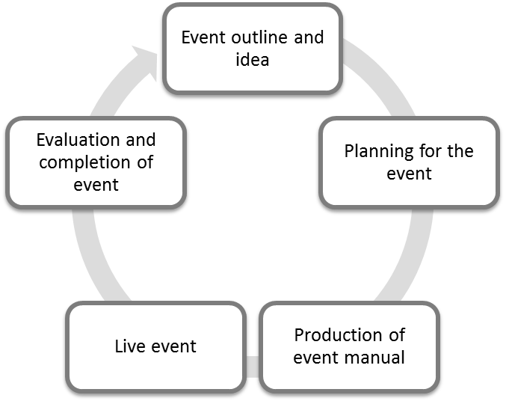
Events Life Cycle

Slide 7
Project Management Tools and Events
Breakdown Structures
Critical Path Method
The Gantt Chart
Risk Management

Slide 8
Critical Path Method
The CPM helps to determine the total time needed to accomplish a project
Identify critical tasks which might endanger a project’s completion on time
CPM supports the early identification of critical tasks
Arising misunderstandings can be eliminated
CPM is an indispensable tool for events planning

Slide 9
Source of Finance for Events
There are two methods of raising money for business development.
  Firstly, there is business equity which covers funds invested by the owner of the business
  There is debt, which is generated by borrowing the money through banks, trade credit or leasing

Slide 10
Internal Sources of Finance
Personal Savings
Sales of Assets
Retained Profit

Slide 11
External Sources of Finance
Bank loans
Overdrafts
Leasing
Business angles
Corporate sponsorship
Formal stock markets
Debentures
Share capitals
Government Grants

Slide 12
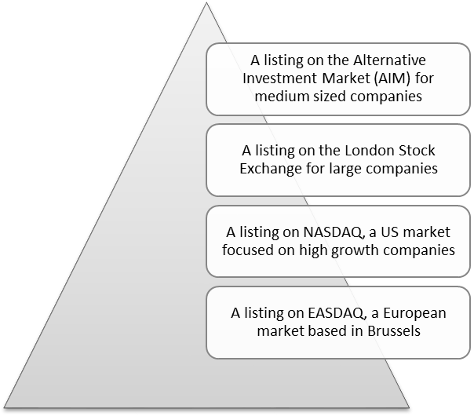
Formal Stock Markets

Slide 13
Fundraising strategies for Events Organsiation
National Government Grants for large-scale events (FIFA World Cup, Olympic Games, Commonwealth Games, etc)
Sponsorship (Venue Sponsors, Prize Sponsors, Digital Sponsors, Media Sponsors etc)
Merchandising Sales (Festival Wristbands, Custom Lip Balm on a Lanyard, Branded festival T-shirts, Branded Power Banks etc)
Participant Fees (Tickets)
Raffles (VIP wristbands, food items, festival T-shirts, free entry ticket etc)

Slide 14
Financing through sponsorship, ticketing and sale of merchandising
Sponsorship is a central source of fundraising for many large-scale events
sponsorship helps events to develop long term relationship with companies:
Increasingly sponsorship practices embrace social, digital and mobile marketing practices as a means of activating partnerships
Many large- and small-scale events have generated revenue by ticketing
Sales of merchandising

Slide 15
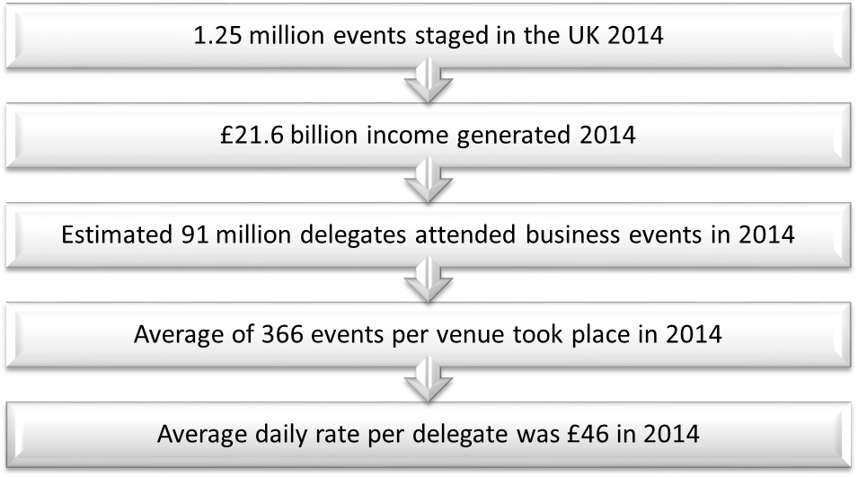
Revenue through Ticket Sales
Source: UK Events Market Trends Survey (UKEMTS) 2014

Slide 16
Summary
Events managers needs to consider key tools of project management
Project management offers planning and control
Finance is vital to the existence of any business
Fundraising also helps an organisation to develop relationships

Slide 17
Further Reading
Burton, N. (2019), "Exploring user sentiment towards sponsorship and ambush marketing", International Journal of Sports Marketing and Sponsorship, Vol. 20 No. 4, pp. 583-602. https://doi.org/10.1108/IJSMS-03-2019-0026
Locker, K. and Kaczmarek, S. (2013) Business Communication: Building Critical Skills: Sixth Edition, McGraw-Hill Higher Education,
UK Events Market Trends Survey (UKEMTS) (2014)
Whova (2021) 9 Steps Event Organizers Can Borrow from Project Managers https://whova.com/blog/steps-event-organizers-borrow-project-managers. [accessed 26/03/2021].

